Slide 1
Floating-Point Square root
Team members:
Ho hai cong thuAn – 18521469
Ha kieu trang – 18521522

Slide 2
Floating-Point Square root
Team members:
Hồ Hải Công Thuận – 18521469
Hà Kiều Trang – 18521522

Slide 3
Contents
Algorithm
Datapath
Controller (FSM)
Simulation result

Slide 4
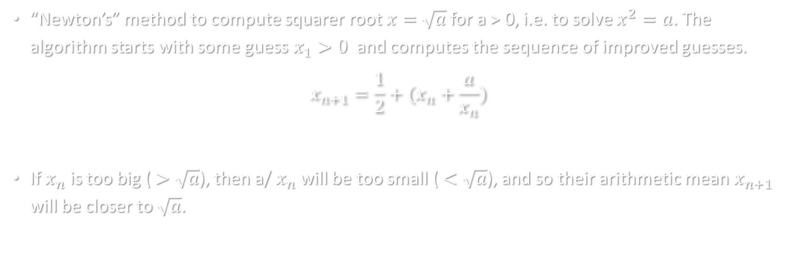
1. Algorithm
“Newton’s” method to compute squarer root $x=$ $\sqrt{a}$ for a > 0, i.e. to solve $x^{2}=a$. The algorithm starts with some guess $x_{1}>0$ and computes the sequence of improved guesses.
$$x_{n+1}=\frac{1}{2}+(x_{n}+\frac{a}{x_{n}})$$
If $x_{n}$ is too big ($>\sqrt{a}$), then a/ $x_{n}$will be too small ($<\sqrt{a}$), and so their arithmetic mean $x_{n+1}$ will be closer to $\sqrt{a}$.

Slide 5
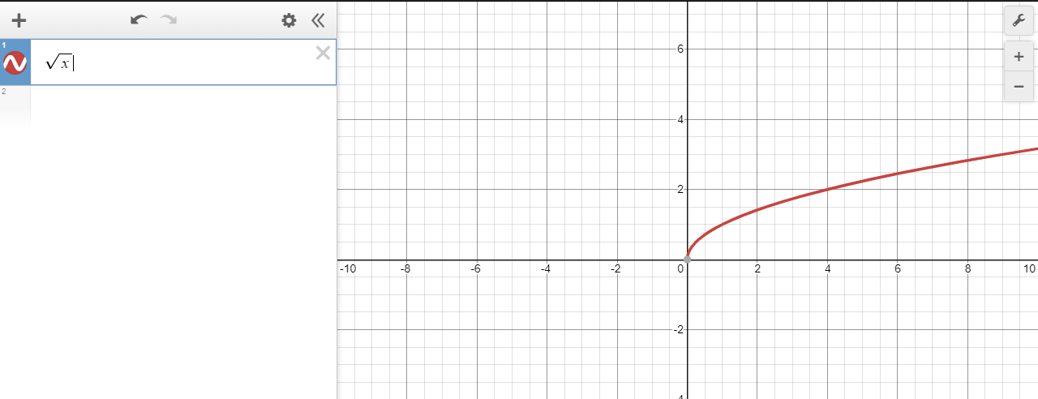
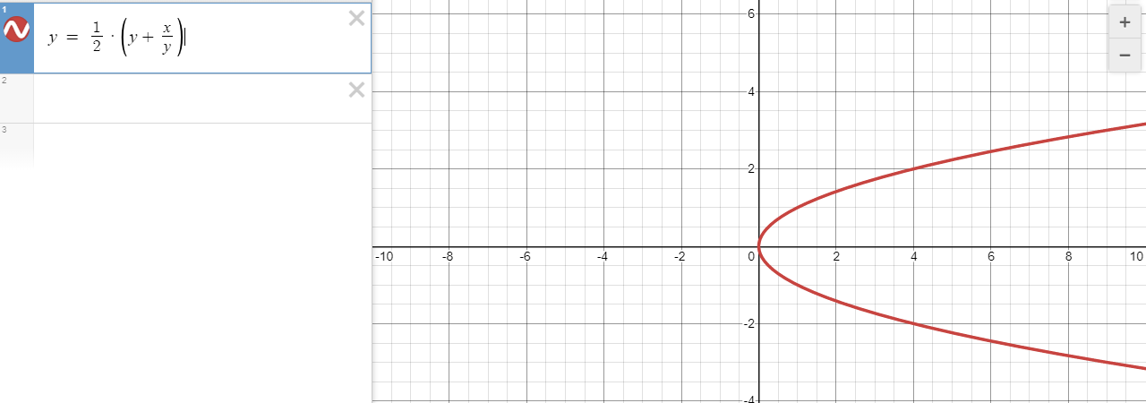
1. Algorithm
Demo on https://www.desmos.com/calculator

Slide 6
1. Algorithm
Proof with testcase using Python
STT | Input | Result from math.sqrt() | Result from the algorithm | Error
1 | 0.0001 | 0.01 | 0.01 | 0.0
2 | 0.0002 | 0.01414213562373095 | 0.01414213562373095 | 0.0
3 | 0.00030000000000000003 | 0.017320508075688773 | 0.017320508075688773 | 0.0
4 | 0.0004 | 0.02 | 0.02 | 0.0
… | … | … | … | …
97 | 0.009699999999999997 | 0.09848857801796103 | 0.09848857801796103 | 0.0
98 | 0.009799999999999996 | 0.09899494936611664 | 0.09899494936611664 | 0.0
99 | 0.009899999999999996 | 0.09949874371066197 | 0.09949874371066197 | 0.0
100 | 0.009999999999999995 | 0.09999999999999998 | 0.09999999999999998 | 0.0

Slide 7
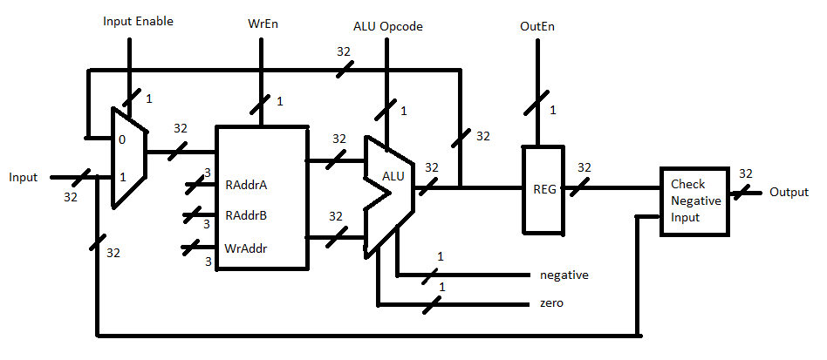
2. Datapath

Slide 8
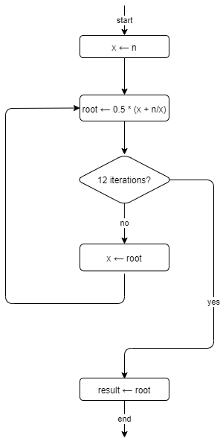
3. Controller (FSM)
S0: Initial state S1: Input number n
S2: x = n;
S3: root = n / x;
S4: root = root + x;
S5 : root = root / 2;
S6: x = root
S7: 12th iteration?
S8: result = root

Slide 9
3. Controller (FSM)
ALU's capable of doing the following operations: add, divide 2 floating-point numbers, divide by 2
ALU's flags:
zero: = 1 when ALU's result is 0
negative: = 1 when ALU's result is < 0

Slide 10
3. Controller (FSM)
We need 6 registers:
RF[0] = 0
RF[1] = n
RF[2] = x
RF[3] = root
RF[4] = 2
RF[5] = result

Slide 11
3. Controller (FSM)
State | IE | Cho phép nhập (WE) | Địa chỉ ghi (ADDR_WR) | Địa chỉ đọc A (ADDR_RDA) | Địa chỉ đọc B (ADDR_RDB) | Thao tác ALU (Opcode) | Cho phép xuất (OE)
0 | 0 | 0 | None | Don’t care | Don't care | Don’t care | 0
1 | 1 | 1 | n | Don’t care | Don’t care | Don’t care | 0
2 | 0 | 1 | x | n | 0 | ADD | 0
3 | 0 | 1 | root | n | x | DIV | 0
4 | 0 | 1 | root | root | x | ADD | 0
5 | 0 | 1 | root | root | 2 | DIV | 0
6 | 0 | 1 | x | root | 0 | ADD | 0
7 | 0 | 0 | result | root | 0 | ADD | 1

Slide 12
3. Controller (FSM)
ADDR_WR | REG
0 (000) | 0
1 (001) | n
2 (010) | x
3 (011) | root
4 (100) | 2
5 (101) | result
State | IE | Allow input(WE) | Writting address (ADDR_WR) | Reading Address A (ADDR_RDA) | Reading Address B (ADDR_RDB) | ALU actions (Opcode) | Output Enable (OE)
0 | 0 | 0 | 000 | 000 | 000 | 0 | 0
1 | 1 | 1 | 001 | 000 | 000 | 0 | 0
2 | 0 | 1 | 010 | 001 | 000 | 0 | 0
3 | 0 | 1 | 011 | 001 | 010 | 1 | 0
4 | 0 | 1 | 011 | 011 | 010 | 0 | 0
5 | 0 | 1 | 011 | 011 | 100 | 1 | 0
6 | 0 | 1 | 010 | 011 | 000 | 0 | 0
7 | 0 | 0 | 111 | 011 | 000 | 0 | 1
Opcode | ALU (FP)
0 | Add
1 | Divide
States
S1: Input number n
S2: x = n;
S3: root = n / x;
S4: root = root + x;
S5 : root = root / 2;
S6: x = root
S7: result = root

Slide 13
4. Simulation result
Case: 1 number after the decimal point
STT | Integer | Result from math.sqrt() | Result from circuit | Error
1 | 0.1 | 0.31622776601683794 | 0.3162277340888977 | 3.192794023609835e-08
2 | 0.2 | 0.4472135954999579 | 0.4472135603427887 | 3.515716923141454e-08
3 | 0.3 | 0.5477225575051661 | 0.5477225184440613 | 3.9061104795123924e-08
4 | 0.4 | 0.6324555320336759 | 0.6324554681777954 | 6.38558804721967e-08
5 | 0.5 | 0.7071067811865476 | 0.5303301215171814 | 0.17677665966936618
… | … | … | … | …
96 | 9.6 | 3.0983866769659336 | 3.098386526107788 | 1.5085814553117416e-07
97 | 9.7 | 3.1144823004794873 | 3.1144821643829346 | 1.3609655269419818e-07
98 | 9.8 | 3.1304951684997055 | 3.130495071411133 | 9.708857273693638e-08
99 | 9.9 | 3.146426544510455 | 3.146426200866699 | 3.4364375567363936e-07
100 | 10.0 | 3.1622776601683795 | 3.1622774600982666 | 2.0007011292122456e-07
Average Error: |  |  |  | 0.005303449494307858

Slide 14
4. Simulation result
Case: 2 number after the decimal point
STT | Integer | Result from math.sqrt() | Result from circuit | Error
1 | 0.01 | 0.1 | 0.09999999403953552 | 5.960464483090178e-09
2 | 0.02 | 0.1414213562373095 | 0.1414213478565216 | 8.38078789699992e-09
3 | 0.03 | 0.17320508075688773 | 0.17320507764816284 | 3.1087248886230157e-09
4 | 0.04 | 0.2 | 0.19999998807907104 | 1.1920928966180355e-08
5 | 0.05 | 0.22360679774997896 | 0.22360678017139435 | 1.757858461570727e-08
… | …
96 | 0.96 | 0.9797958971132712 | 0.9797958135604858 | 8.355278535709942e-08
97 | 0.97 | 0.9848857801796105 | 0.9848856925964355 | 8.758317493473555e-08
98 | 0.98 | 0.9899494936611666 | 0.9899494051933289 | 8.84678377222059e-08
99 | 0.99 | 0.99498743710662 | 0.9949873685836792 | 6.852294076598042e-08
100 | 1.00 | 1.0 | 1.0 | 0.0
Average Error: |  |  |  | 0.0017678117905553198

Slide 15
4. Simulation result
Case: 3 number after the decimal point
STT | Integer | Result from math.sqrt() | Result from circuit | Error
1 | 0.001 | 0.03162277660168379 | 0.03162277489900589 | 1.702677901449512e-09
2 | 0.002 | 0.044721359549995794 | 0.04472135379910469 | 5.7508911036063814e-09
3 | 0.003 | 0.05477225575051661 | 0.05477225035429001 | 5.396226604448273e-09
4 | 0.004 | 0.06324555320336758 | 0.06324554979801178 | 3.405355802899024e-09
5 | 0.005 | 0.07071067811865475 | 0.0707106739282608 | 4.19039394849996e-09
… | …
96 | 0.096 | 0.30983866769659335 | 0.3098386526107788 | 1.5085814542015186e-08
97 | 0.097 | 0.31144823004794875 | 0.31144821643829346 | 1.3609655291624279e-08
98 | 0.098 | 0.31304951684997057 | 0.3130494952201843 | 2.1629786239873994e-08
99 | 0.099 | 0.31464265445104544 | 0.31464263796806335 | 1.6482982090337828e-08
100 | 0.100 | 0.31622776601683794 | 0.3162277340888977 | 3.192794023609835e-08
Average Error: |  |  |  | 1.5289009067734338e-08

Slide 16
4. Simulation result
Case: Input is a negative number.
STT | Integer | Result from math.sqrt() | Result from circuit | Error
1 | -0.1 | Error | NaN | N/A
2 | -0.2 | Error | NaN | N/A
3 | -0.3 | Error | NaN | N/A
4 | -0.4 | Error | NaN | N/A
5 | -0.5 | Error | NaN | N/A
… | … | … | … | …
96 | -9.6 | Error | NaN | N/A
97 | -9.7 | Error | NaN | N/A
98 | -9.8 | Error | NaN | N/A
99 | -9.9 | Error | NaN | N/A
100 | -10.0 | Error | NaN | N/A
Average Error: |  |  |  | N/A

Slide 17
4. Simulation result
STT | Case name | Longest time between input and output (ps)
1 | 0.1 – 10.0 | 5059350
2 | 0.01 – 1.00 | 5058978
3 | 0.001 – 0.100 | 5059890
4 | 1.0 – 100.0 | 5059890
5 | Input = -x.0 (eg -1.0, -2.0,…) | 11954

Slide 18

4. Simulation result
Frequency = 1 / Max (the longest time between input and output)
= $\frac{1}{5059890 ∗{10}^{−12}}$ = 197 632.7549 (Hz)
Number of cycles: 51
One clock cycle = 100 000 (ps)

Slide 19
THANK YOU FOR ALL YOUR ATTENTION

Slide 20
4. Simulation result
Case: Input = x.0 (eg 1.0, 2.0,…)
STT | Integer | Binary | Expected result | Expected result binary | Result integer | Result binary | Tolerance
1 | 1.0 | 0 10000000 00000000000000000000000 | 3.0 | 0 10000000 10000000000000000000000 | 3.0 | 0 10000000 10000000000000000000000
2
3
4
5

Slide 21
4. Simulation result
Case Input = x.0y (eg 1.01, 1.02,…)
STT | Integer | Binary | Expected result | Expected result binary | Result integer | Result binary | Tolerance
1
2
3
4
5

Slide 22
4. Simulation result
Case Input = x.00y (eg 1.001, 1.002,…)
STT | Integer | Binary | Expected result | Expected result binary | Result integer | Result binary | Tolerance
1
2
3
4
5

Slide 23
4. Simulation result
Case Input = x.000y (eg 1.0001, 1.0002…)
STT | Integer | Binary | Expected result | Expected result binary | Result integer | Result binary | Tolerance
1
2
3
4
5

Slide 24
4. Simulation result
Case Input = -x.0 (eg -1.0, -2.0,…)
STT | Integer | Binary | Expected result | Expected result binary | Result integer | Result binary | Tolerance
1
2
3
4
5

Slide 25
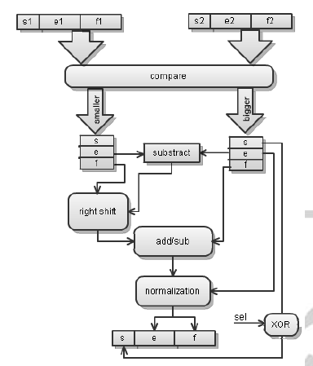
1. Algorithm
Adder

Slide 26
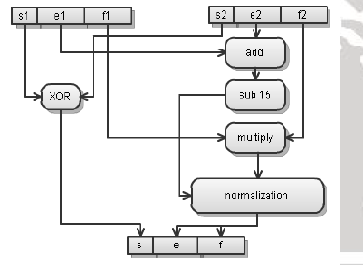
1. Algorithm
Multiplier

Slide 27
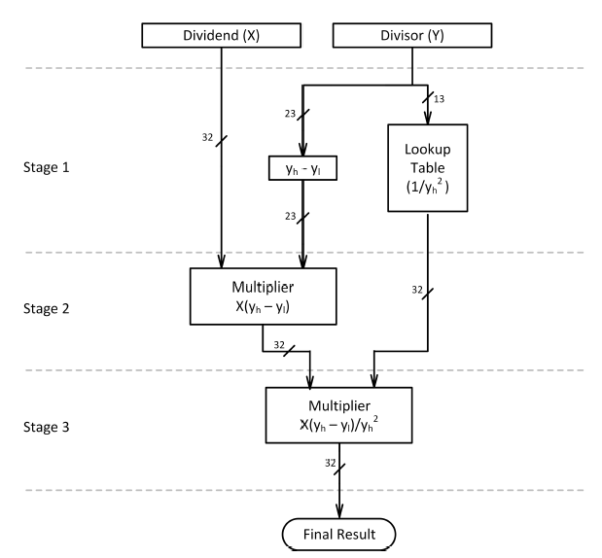
1. Algorithm
Division

